Slide 1
Advanced Skin Disease Diagnosis
Team 7

Slide 2
Introduction
Advanced skin disease diagnosis leverages cutting-edge technologies to improve the accuracy and efficiency of diagnosing various skin conditions. These technologies analyze large datasets of skin images to identify patterns and features associated with different skin diseases, including common conditions like acne, psoriasis, and more serious ones like melanoma and other skin cancers.
The technologies which we use can detect skin diseases at an early stage, which is crucial for effective treatment, especially for conditions like melanoma.
Early and accurate diagnosis can reduce the need for extensive treatments or hospitalizations, saving costs for patients and healthcare systems.
Technology enables patients to track skin changes over time, stay informed, and seek medical advice proactively, fostering a more proactive approach to skin health.

Slide 3
Project Overview
CREATE a new user account to access the application. LOGIN with your username and password. INPUT upload the picture. VIEW the after results the and the medical history details.
Customer Features

Slide 4
MILESTONE
The system allows users to register ,login and verify password reset functionality and security measures to protect user data.
OpenCV (Open Source Computer Vision Library) is a popular open-source library used for computer vision and image processing tasks. It provides tools and algorithms for tasks such as object detection, face recognition, image filtering, feature extraction, and more. OpenCV is commonly used in Python due to its ease of use, speed, and large community support.

Slide 5
MILESTONE
We implemented the UI to read an image from user, process that image with OpenCV to calculate the dimensions of the skin disease area in UI back
We prepared the dataset for training the model to generate approximate accurate values.

Slide 6

HOME PAGE:
Takes you to registration page.

Slide 7
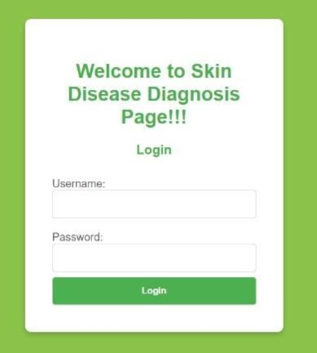
LOGIN PAGE:
User have to enter their login credentials
Username and Password
If the login credentials provided are correct the it gets redirected to profile page else “Invalid username and password” will be displayed.

Slide 8

SIGNUP PAGE:
Give a new user name which is non pre existent
Give a unique password with 8 characters
Confirm the password
After filling required information click signing then it redirects you to profile page
And you account will be created.

Slide 9
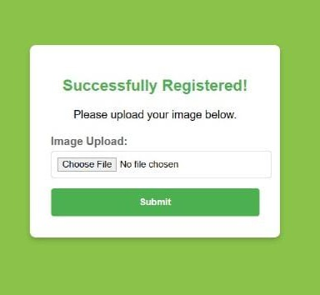
PROFILE PAGE:
A simple user interface for an eased user Experience
User can choose a file and upload here.

Slide 10
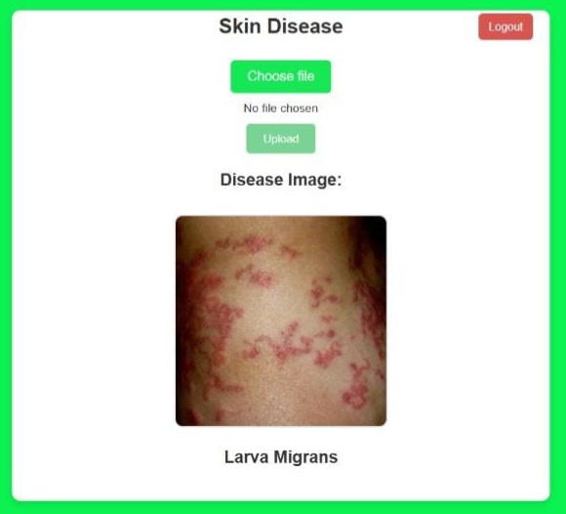
PROFILE PAGE AFTER UPLOADING THE IMAGE:

Slide 11
MODEL TRAINING PROCESS
Data preparation:
Images from various categories are intaken applies processing transformations.
Creates data loaders for batch processing during model training. Normalises and
standardise feature extraction.
Processed visualizatuon:
Visualizes preprocessor images from training dataset and maps them to their
corresponding class labels. Class labels corresponds to different skin conditions
(BA cellulitis , VI chickenpox , ringworms).

Slide 12
MODEL TRAINING PROCESS
Model Training and Evaluation
We explored two models based on feature extraction and classification tasks. Extracts
spatial patterns using convolution neural networks. DenseNet-121(Transfer Learning)
leverages imageNet-trained weights for feature extraction.
Achieved 74% accuracy on test data set.
Integration
The trained SVM model was saved as a “.joblib” file. This file was Integrated into the
systems peofile page for inference.

Slide 13
ABOUT MODEL
Initial Approach:
Combination of Visual Transformers (ViT) from PyTorch and Scikit-learn models.
GPU Utilization: PyTorch’s support for CUDA accelerated training significantly.
Challenges:
Despite achieving 97.86% testing accuracy, the PyTorch model exhibited overfitting and was deprecated.
Current Approach:
Adopted Scikit-learn models exclusively.
Tried various models: SVM, Logistic Regression,Decision Trees, Naïve Bayes, and KNN.
Final Selection:
SVM with Linear Kernel: Best testing accuracy (74%) without overfitting or underfitting.
This analysis reflects the progressive refinement of the model to achieve a balance between accuracy and generalization.

Slide 14
Conclusion
Advanced skin disease diagnosis using image processing is revolutionizing dermatology. It enhances the accuracy and speed of diagnosing skin conditions, allows for early detection, and improves access to quality care, especially in remote areas. This technology promises to transform dermatological care, leading to better patient outcomes and more effective treatments.

Slide 15
CONCLUSION
The Advanced Skin Disease Detection System is a robust AI-driven image analysis platform that integrates deep learning and machine learning technologies to assist in diagnosing skin conditions with high precision. This system processes skin images to identify potential conditions, offering users accurate and valuable insights into their skin health.
By addressing skin-related concerns with accuracy and efficiency, this project demonstrates the potential of AI in revolutionizing healthcare, offering a scalable, cost-effective, and user-friendly diagnostic tool for skin diseases. This work serves as a stepping stone for future advancements in AI-based medical diagnostics, empowering individuals with greater control over their health.

Slide 16
Team Members
01
03
02
Pallerla Uha
Vyshnavi Bharath
Sahithi

Slide 17
THANK YOU
z

